Slide 1
ENDOSCOPIA DI REVISIONE DOPO SLEEVE
A.D’ALESSANDRO
PINETA GRANDE HOSPITAL
CASTELVOLTURNO (CE)

Slide 2
WEIGHT REGAIN AFTER SLEEVE GASTRECTOMY
5-37%
6%:2a - 76%:6a
20% re op 7a

Slide 3
WEIGHT REGAIN: WHAT WENT WRONG?

Slide 4
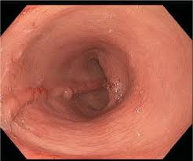
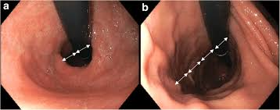
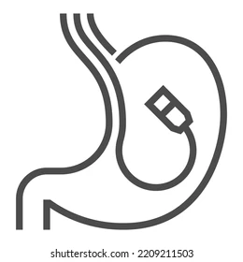
WEIGHT REGAIN: WHAT WENT WRONG?
Wide sleeve
Sleeve dilatation
…YES, WE CAN…

Slide 5
WR AFTER SLEEVE GASTRECTOMY
Annals of Medicine and Surgery 2022

Slide 6
STANDARD SLEEVE GASTRECTOMY

Slide 7
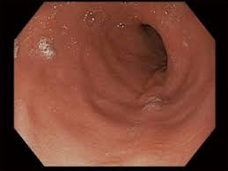
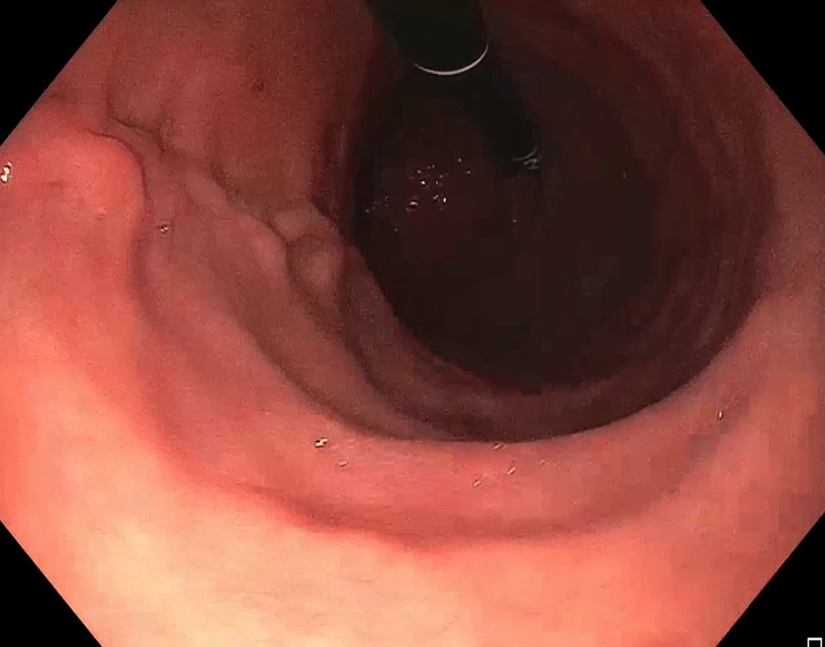
NOT-STANDARD MEASUREMENT
OPTICAL EVALUATION or BALOON
ANGULUS RETROVERSION
RADIOLOGICAL EVALUATION

Slide 8
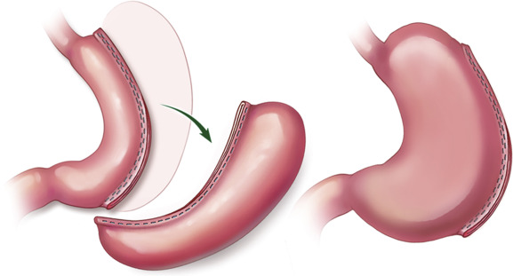
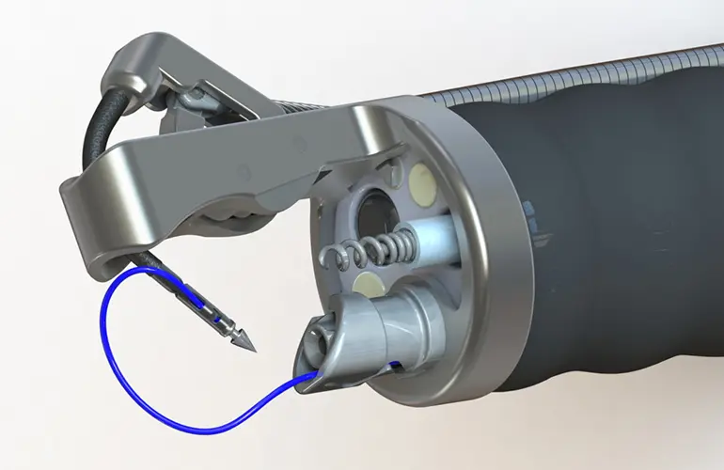
ENDOSCOPIC REVISION OF SLEEVE GASTRECTOMY

Slide 9
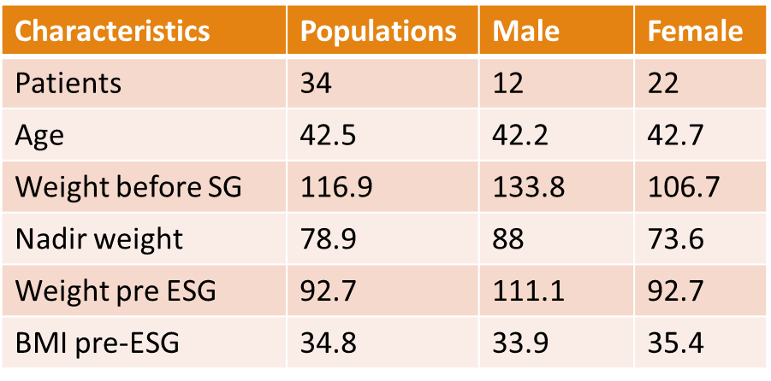
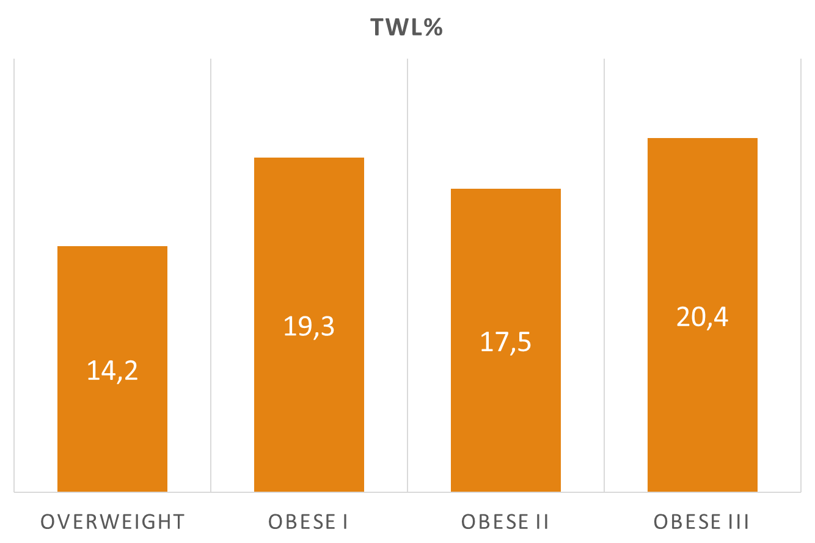
OUTCOME - APOLLO
Endoscopic Sleeve gastroplasty in the management of weight regain after sleeve gastrectomy
De Moura et al. Endoscopy 2020

Slide 10
OUTCOME - APOLLO

Slide 11
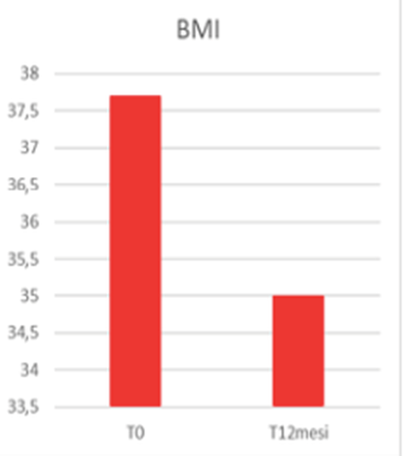
PERSONAL DATA AND TECHNIQUE
Unpublished data n = 52
F.U. : 18 months

Slide 12
OUTCOME - POSE
n: 15 ; 9.0%, 12.9%, and 15.7% total weight loss
3, 6, and 12 months, respectively

Slide 13
REDO-rESG
All bariatric endoscopic procedures are repeatable
Data on efficacy are limited
Further studies are necessary

Slide 14
SEVERE ADVERSE EVENTS
0
Endoscopic Sleeve gastroplasty in the management of weight regain after sleeve gastrectomy
Stenosis:
Endsocopic
dilatation
0
Late Bleeding:
Endoscopic
treatment
Personal data

Slide 15
SUMMERIZING
EFFICACE?
Si….ma meno della chirurgia
SICURA?
Si….ma i dati non sono ancora sufficienti

Slide 16
SO…MAKE IT MAKE SENSE
NO DATA ON LATE COMPLICATION OF BARIATRIC ENDOSCOPY

Slide 17
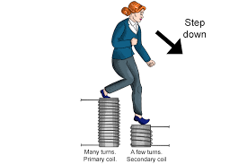
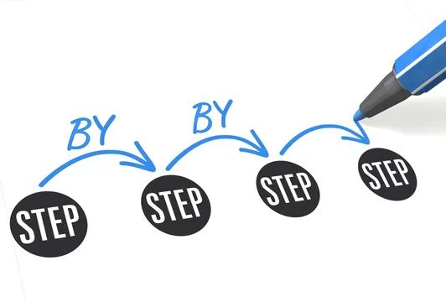
STEP-UP? STEP DOWN? STEP BY STEP?
Age
Family and personal history
Eating beahviour
Social and psychological background
Comorbidities
Cardio-vascular risk
..

Slide 18
CONCLUSIONS
OBESITY IS A CHRONIC DISEASE WITH A HIGH RATE OF RELAPSE AFTER TREATMENT
PATIENTS REFERRING FOR WEIGHT REGAIN AFTER BARIATRIC SURGERY ARE COMPLEX
ENDOSCOPIC REVISION OF SLEEVE GASTRECTOMY REPRESENTS A SAFE AND EFFECTIVE TECHNIQUE ACCORDING TO AVAILABLE DATA
ENDOSCOPIC PROCEDURES ARE REPEATABLE
DATA ON LATE COMPLICATIONS OF BARIATRIC ENDOSCOPY ARE LACKING
WE SHOULD ACHIEVE A TARGET THERAPY FOR DIFFERENT OBESE PATIENTS WORKING TOGETHER WITH ALL SPECIALISTS (NUTRIZIONISTS, PSYCHOLOGISTS, SURGEONS, ENDOCRINOLOGISTS….)

Slide 19
Grazie

